Slide 1
War on Terror
UNITED STATES AND ITS WAR ON TERROR

Slide 2
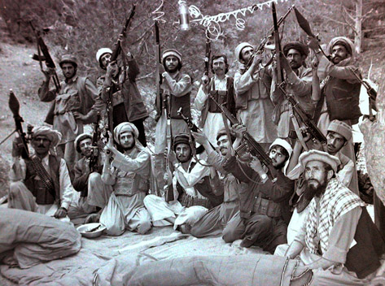
Soviet war: Rise of a Nation
Entire Afghan nation rose in arms
6 millions migrated to Pakistan and Iran, clearing the battle field for war

Slide 3
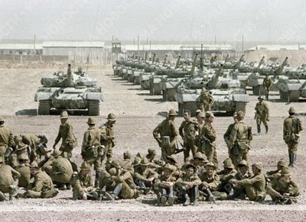
Ideological Ground
Soviets were alien troops not knowing local language, culture, people, terrain or history
Soviets were not willing to die for their cause
Resistance had high moral ground considered dying a noble cause!

Slide 4
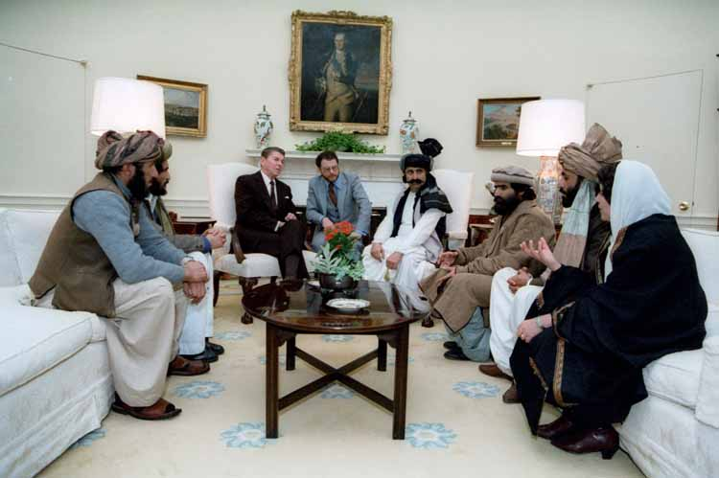
Supported War
Mujahedeen received international diplomatic and political support
US, China, Saudi Arabia, Pakistan, UN
Hundreds of Base areas and training camps in Pakistan
Non-stop supply of
fresh fighters from
refugees & Muslim groups
Local Afghan government acted as collaborators to Soviets but remained unreliable ally.

Slide 5
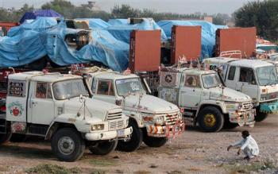
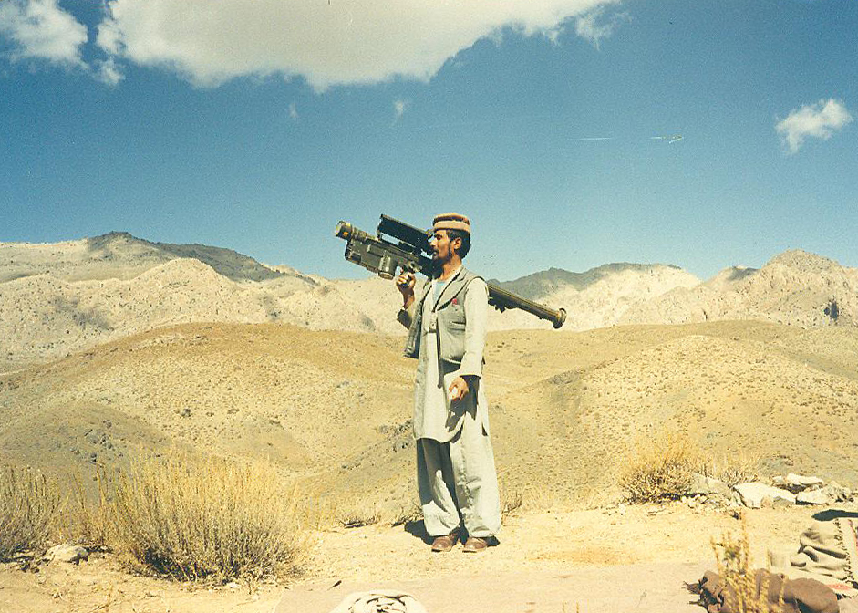
Logistic Support
Massive uninterrupted logistical, weapons and ammo supplies into Afghanistan
ISI conducted the entire operation - “Death by a thousand cuts” strategy!
SAM’s and ATGM’s played a decisive role in Soviet defeat in later years – between 1986 to 1988

Slide 6
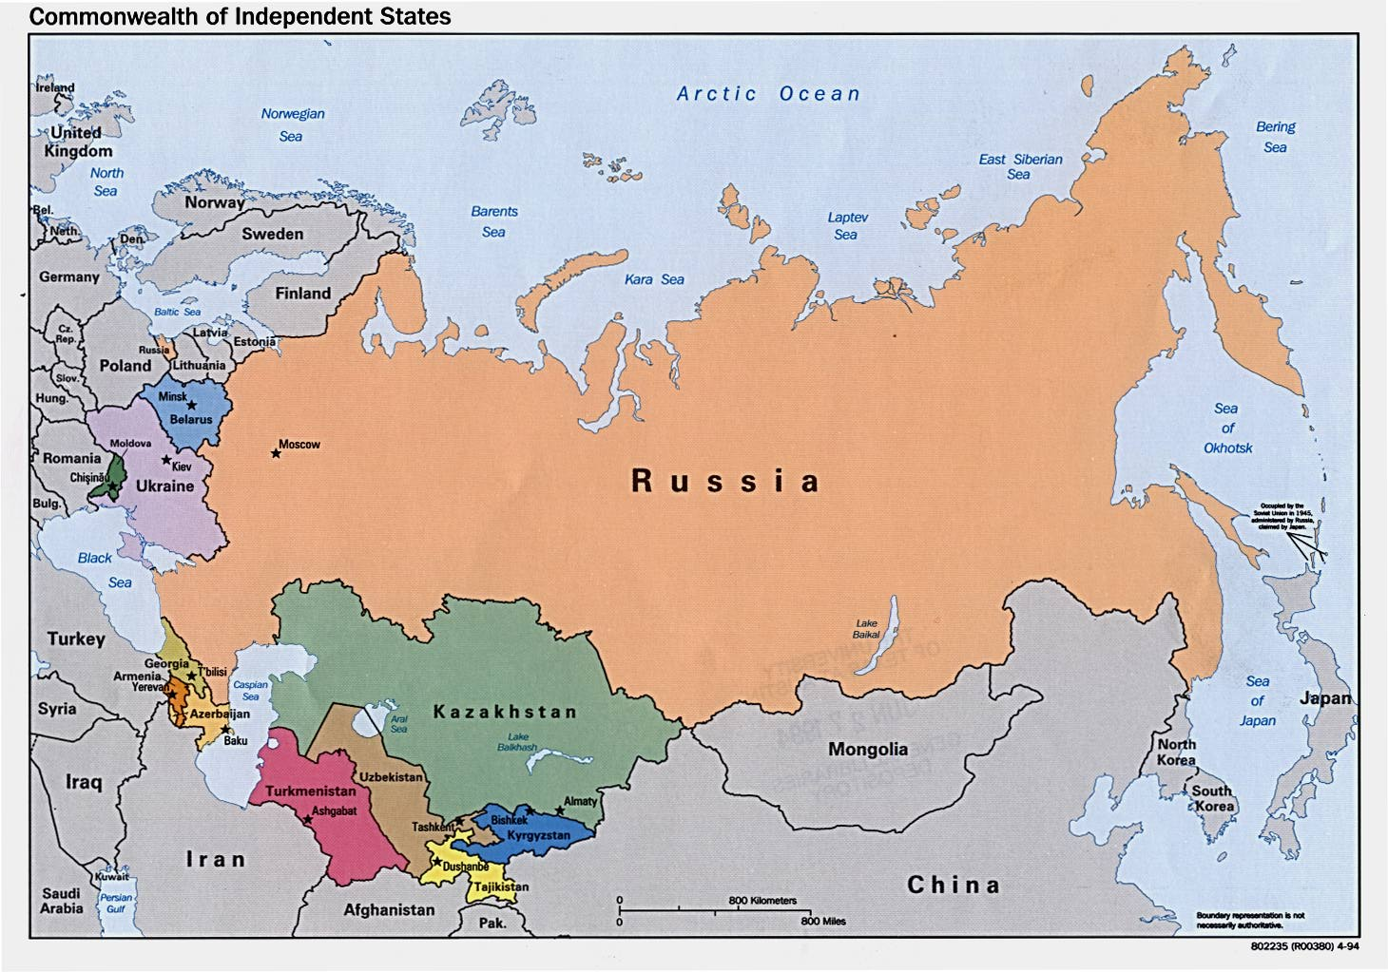
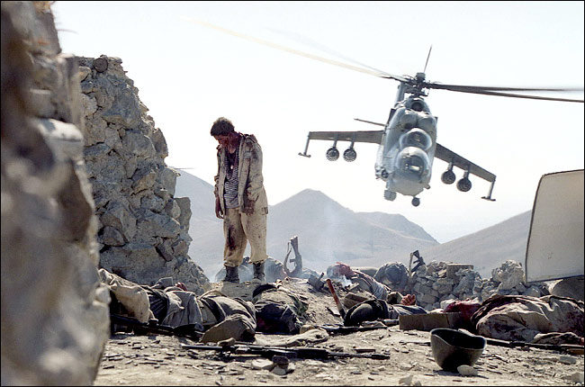
Breakup of Soviet Empire
Disastrous campaign
that ended with
the disintegration of
this former Communist
super power.

Slide 7
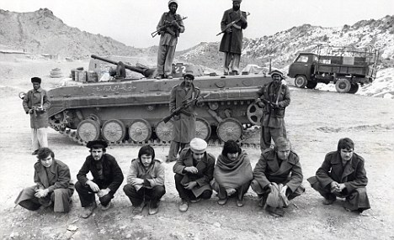
Invasion: A Blunder of Historic Proportions
Soviet Union lost DURING THIS ABORTIVE CAMPAIGN:
14,453+ combat soldiers and 1979 officers

Slide 8
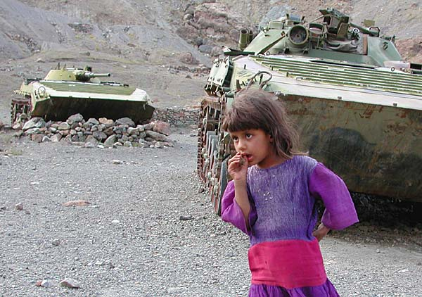
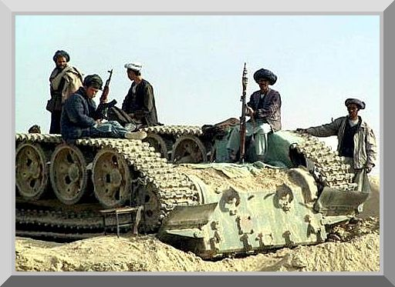
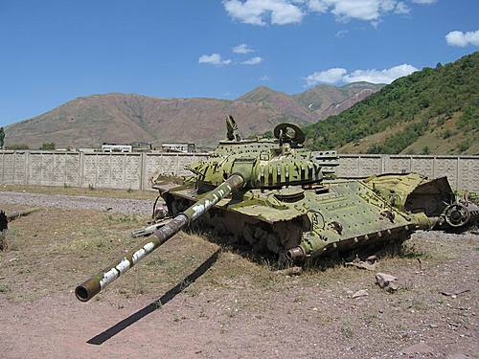
10 YEARS OF DEFEAT
USSR LOST :
.
11,369 cargo and fuel Tanker Trucks and 147 Tanks.

Slide 9
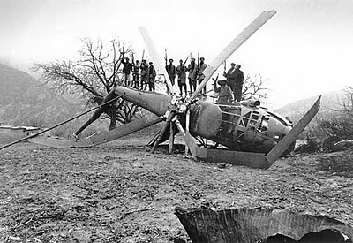
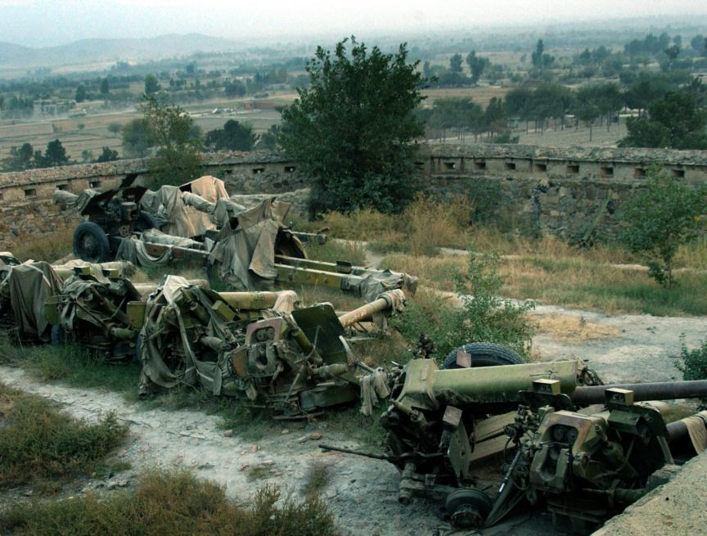
10 YEARS OF DEFEAT
USSR LOST :
.
333 helicopters
114 Aircrafts
1315 APCs
433 Artillery Guns

Slide 10
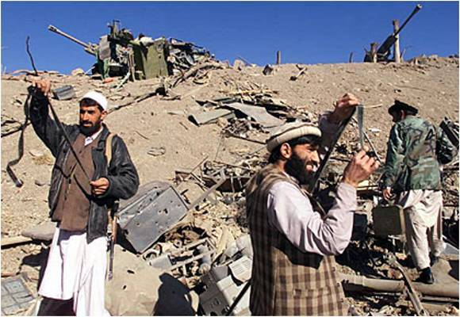
US / NATO : Afghan War
The resistance is from Pashtun population only
Taliban, Hekmatyar, Haqqani.
mass migration of population
international support and recognition
of anti-coalition resistance militia (ACM)!
training camps and base areas for
resistance in Pakistan
weapons, ammunition or logistical
supply line from Pakistan
regular supply of fresh fighters from Pakistan
as resistance is mostly based inside Afghanistan

Slide 11
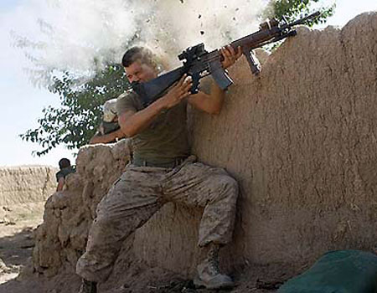
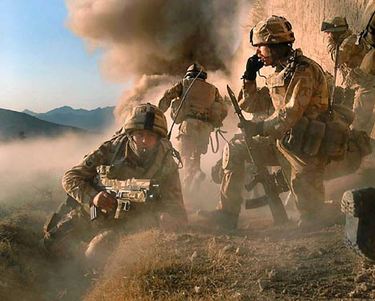
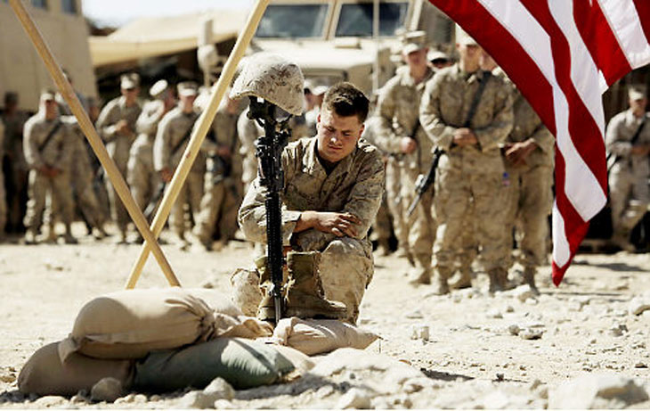
US / NATO : Afghan War
US/NATO :
remains foreign forces, alien to local
culture, language and terrain
also relying on local collaborators who
remain unreliable and weak
forces on weak moral ground, not willing to die for the cause
ACM remain on high moral ground, fighting to liberate their lands, willing to take risk and die!
ISI not supporting or organizing the resistance
Resistance does not have SAM’s or ATGM’s !

Slide 12
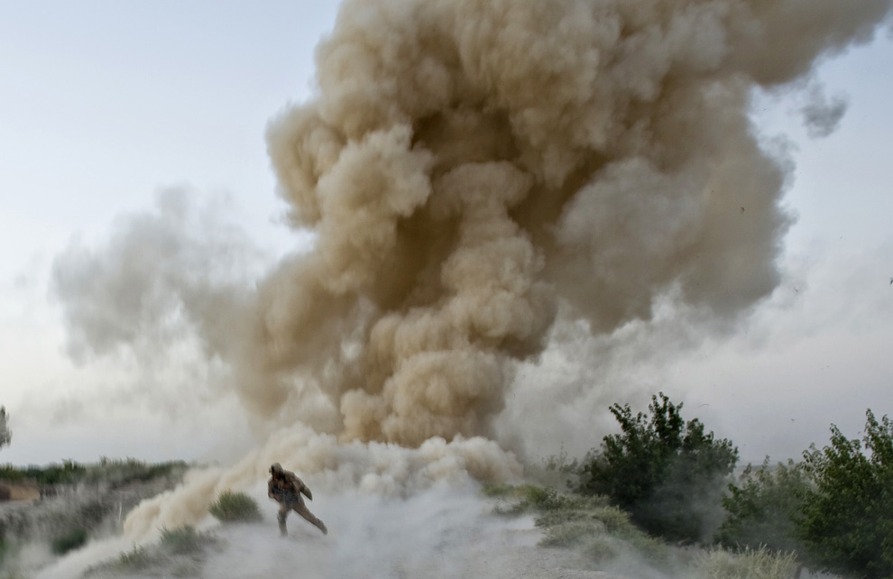
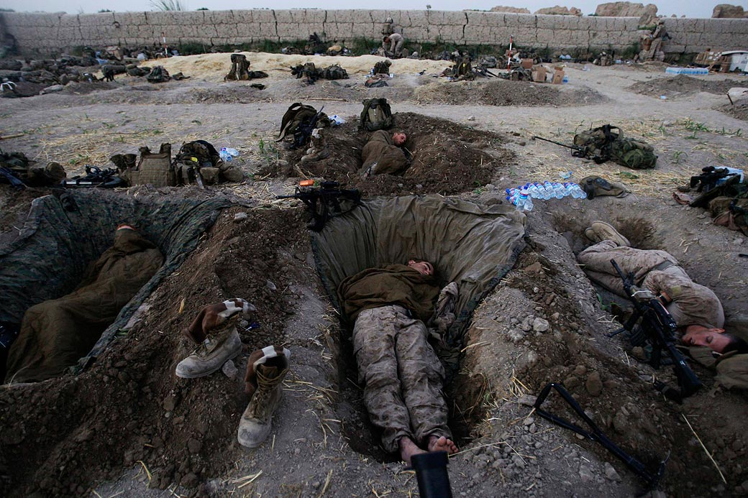
US / NATO : Afghan War
No clear strategy within
occupation forces
Still, resistance is going on for 10 years and still going strong!
Cost of war in men and material rising exponentially for the occupation!

Slide 13
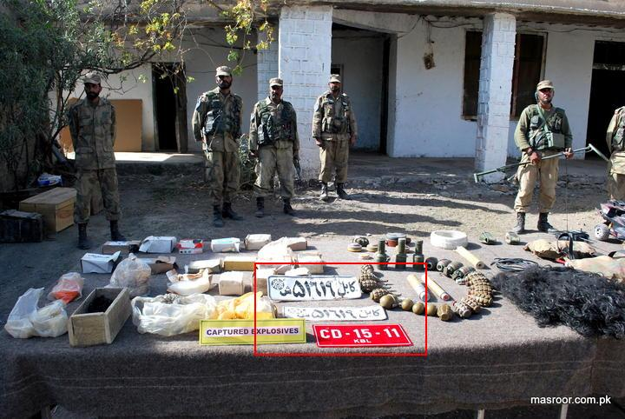
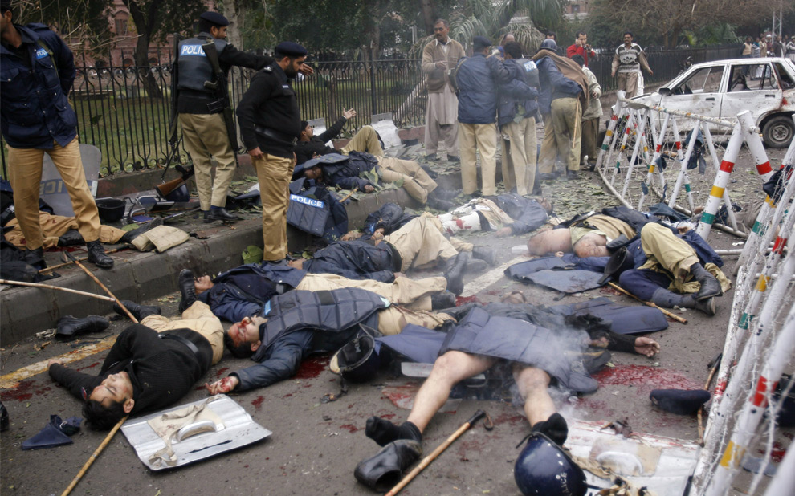
T T P: Hallmarks
Ideologically different from ACM in Afghanistan
Does not fight US/NATO but wages war against state of Pakistan!
Fully armed, equipped, financially strong insurgency with base areas in Afghanistan
Supply route of weapons, explosives, communication equipment and fighters remain open from Afghanistan

Slide 14
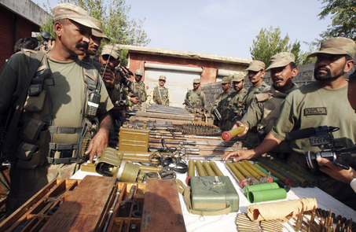
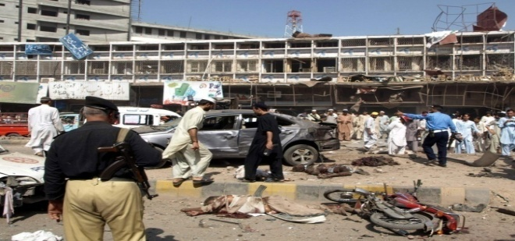
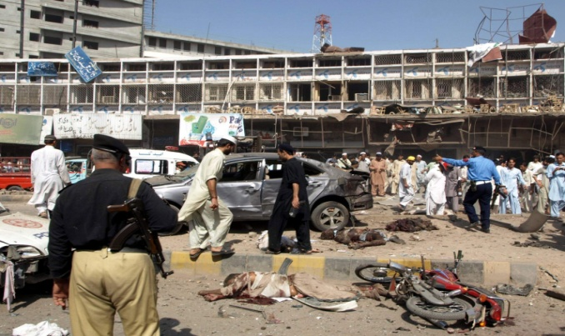
T T P : Hallmarks
Fighting style, weapons, strategy, terrain and
fighters are similar within Afghan ACM and TTP
The sponsors and backers of TTP are based in Afghanistan – Indian RAW or US CIA?
Most ruthless in the world – deploying
suicide bombers as strategic weapon
Thousands of suicide bombings, IED’s and
attacks against forces, civilians and law enforcement agencies in last 4 years alone
Over 40,000 civilians killed in last 4 years -
10,000 soldiers and officers killed or wounded
High intensity asymmetric war in urban environment
continues against TTP in FATA and mainland

Slide 15
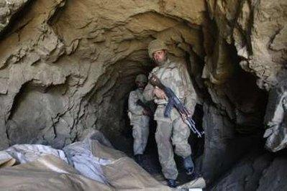
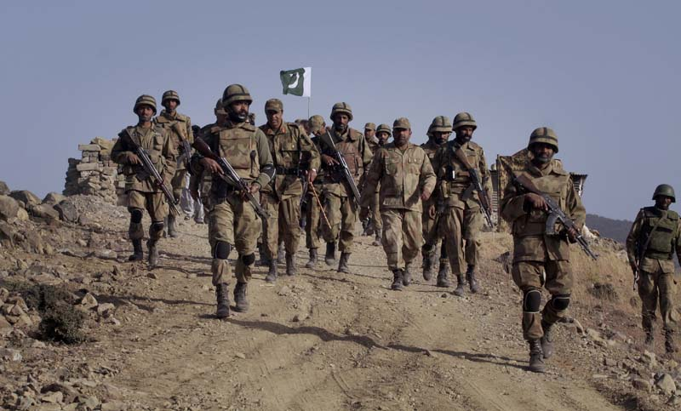
T T P : Pak Army Operations
Area as big as England – hilly, mountainous and valleys, inaccessible, ideal for guerilla warfare against regular army
Enemy was well dug in mountains, well equipped and had local knowledge. Almost 25,000 fully armed fighters with the enemy and had taken over the entire valley, passes, cities and strategic hilltops
Local population almost 3 million, supportive of army and anti-TTP
The entire population migrated out of the valley, clearing the battle field allowing the army to operate freely!
Army is local to the country, understands language, culture, terrain, people and
tactics of the fighters
Army liberating its own home ground against an unpopular terrorist group and was willing to fight and die for the cause. Moral was high, officers and men volunteered for dangerous operations.

Slide 16
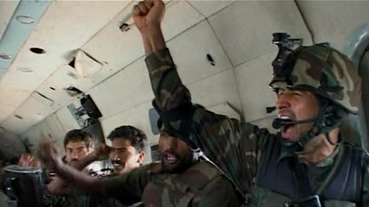
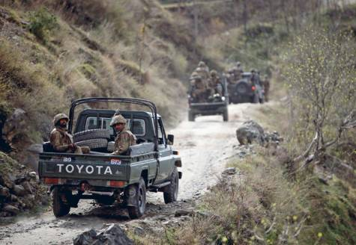
T T P : Pak Army Operation
Enemy and objective was clearly defined. No strategic or tactical confusions!
Army willing to deploy daring unconventional tactics – largest heliborne landing in Asia ever of 4000 Special forces deep into the mountains, behind enemy lines surprised the insurgency. The General officer led the landing himself in terrorist infested mountains!
The area was cleared in less than two months in a classic counter insurgency
operation which is now stuff of the legends and movies are being made on it!
The entire population of 3 million moved back into the valley immediately after
the operation and now Swat is cleared and being rebuilt rapidly
The most successful counter insurgency operation ever in the world

Slide 17
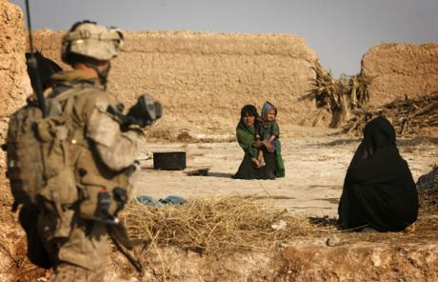
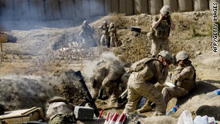
US / NATO: Occupation forces
Occupation force – hated by insurgency
and common man alike. Latest riots in
Mazaar Shareef against UN are ample
example
Relying on unreliable Afghans who have
no roots in population
Occupation forces alien to local
language, culture, tribes and terrain
fighting a war without objectives, goals
and no high moral ground. Morale is
lowest
Not willing to die. Emphasis is on survival and use of technology, causing more collateral damage making them more unpopular!
Barking up the wrong tree
– wrong threat analysis
– blaming Pakistan for their failures instead of addressing the issues inside Afghanistan – North Waziristan has nothing to do with wars in Kandahar or Helmand, the fiercest battlefields

Slide 18
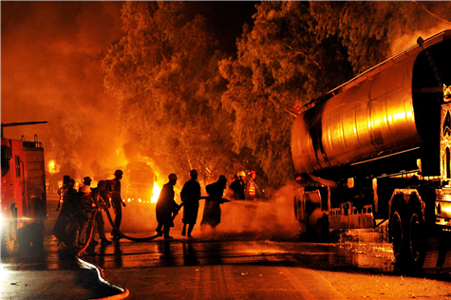
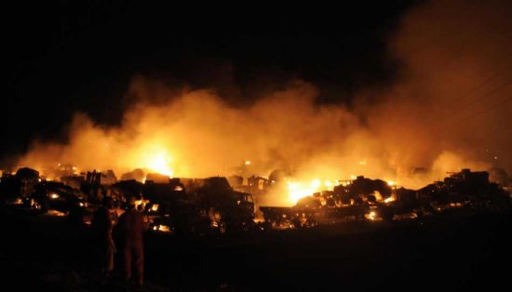
US / NATO: Burning Logistics
War Cost crippling the economy at home
NATO supplies remain vulnerable in Pakistan – the weakest and most vulnerable link in the logistical support
Taliban remain flushed with money as NATO and drug lords pays them for safe transit of convoys and drug
consignments. Weapons and
ammo come from robbing NATO
supplies, Afghan army pilferage,
and open black market in tribal
areas and central Asia and Iran

Slide 19
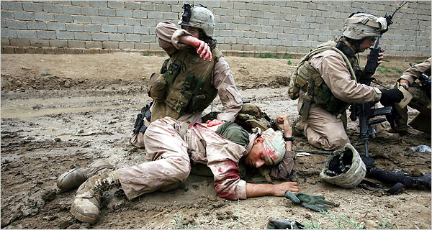
US / NATO Fate : Defeat
All signs are that the fate of the present occupation forces would be identical to Soviets
Soviet Union saw the defeat too late, signed the Geneva accord and tried to find an exit but the staggering cost of the war destroyed the Soviet empire
Present occupation forces are still not negotiating an exit, still feel they can win the war and have still not learnt from the 10 years of this present conflict

Slide 20
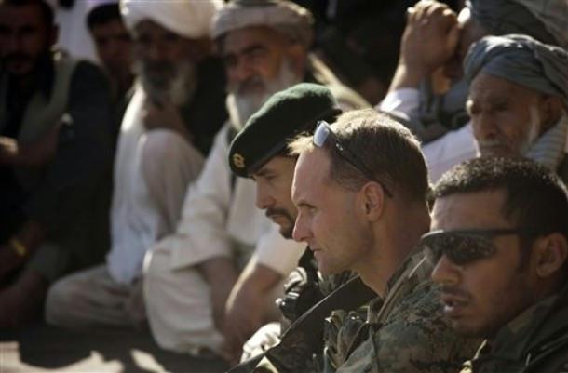
US / NATO Fate : Defeat
Pashtun resistance remains decentralized and dispersed in various separate groups in regions from Kunar in north East to Helmend in south East, with pockets all over the country – making it almost impossible to strike at the centre of gravity or to decapitate the resistance.
Pakistan or the Pakistani tribals are still not supporting the Pashtun resistance nor providing any base areas or supplies but things can change in future if Pashtuns are persecuted in Afghanistan or TTP insurgency continue to get support from Afghanistan. Relations between ISI and CIA are most tense and almost at rock bottom these days.

Slide 21
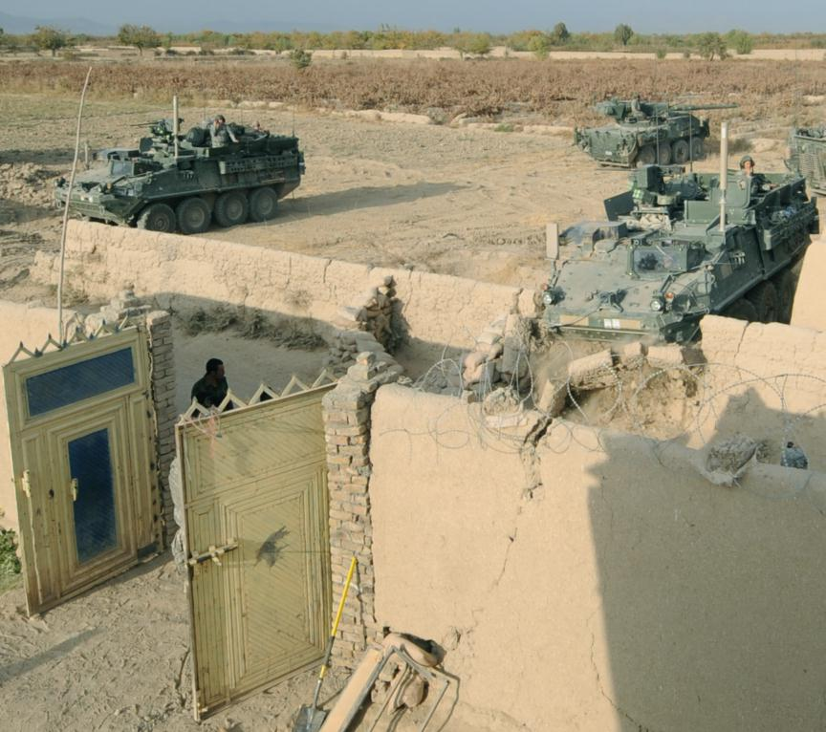
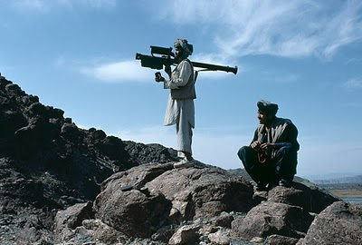
US / NATO Fate : Defeat
In desperation, force is being used more indiscriminately causing more and more civilian casualties – creating more hatred even within non-Pashtun groups. All the signs are that Tajik and Uzbek groups would also join the resistance in Northern regions
Resistance is trying to get SAM’s. Russian black market or Iran or even China could provide. That would be a game changer!
Occupation forces should work on a serious exit plan and start to talk with the Pashtun resistance
The Karzai regime has no future

